Slide 1
A Raisin in the Sun
Lorraine Hansberry

Slide 2
About the author. . .
Deeply committed to the black struggle for equality and human rights, Lorraine Hansberry's brilliant career as a writer was cut short by her death when she was only 35.
A Raisin in the Sun was the first play written by a black woman to be produced on Broadway. It won the New York Drama Critics Circle Award - Hansberry was the youngest and the first black writer to receive this award.

Slide 3
Purpose for writing. . .
Hansberry's purpose was to show "the many gradations in even one Negro family." The characters suffer, hope, dream, and triumph over the enormous barriers erected by the dominant culture.

Slide 4
Themes in ARINS
pursuit of the American dream
American beauty & identity (and how race & gender contribute to these)
class and generational conflicts
marital relationships
feminism (of the daughter in particular)
stereotyping, misconceptions, inequality myths regarding race, class, and gender
universality of the human race

Slide 5
Setting/Background:
The entire action of the play takes place in the
Southside of Chicago sometime between WWII and present (1958): namely the 1950’s.
During this era, Chicago was strictly divided by race and segregation. The 1950’s are often considered a prosperous time for the United States; a time where blacks were “content with their inferior status, and women were happy to stay at home and be housewives”.

Slide 6
Setting/Background:
This of course caused great tension in both blacks and women and ultimately led to the great civil rights and feminist movements in the 1960’s.
A Raisin in the Sun predates both of these movements, but provides great insight into life during this time period and how it erupted into the 60’s.

Slide 7
Harlem Renaissance. . .
1) war generates new opportunities for industry
2) much of existing labor supply leaves work force
3) immigrant labor pool evaporates.
Result = The Great Migration
congregated black populations in northern cities like Chicago and New York in unprecedented numbers.
The concentration, in New York city, occurred on the upper west side, in Harlem.

Slide 8
Harlem Renaissance
When Harlem was built in 1904 it was designed for the upper class white community; it consisted of townhouses, luxury apartment buildings and single-family homes.
In its youth, Harlem was a somewhat fashionable section of the city with a large black, middle class population. Because New York is a port city, blacks from the south, Africa and the West Indies also found their way to Harlem making it a truly cosmopolitan area.

Slide 9
Harlem Renaissance
Important Features of the HR:
more than just a literary movement
racial consciousness & integration (assimilation vs. pride in heritage)
the explosion of art & music--jazz, spirituals and blues (and tension with dreams being "deferred")

Slide 10
Harlem Renaissance
Common subjects:
Alienation
Marginality
the use of folk material
the use of the blues tradition
the problems of writing for an elite audience.

Slide 11
The Characters: 5th Period
Ruth Younger- Shania
Travis Younger-Bryce
Willy-Arzoo
Walter Lee Younger-Denny
Beneatha- PuriTy
Mrs. Johnson-LeeAnna
Lena Younger (Mama)-Jade
Joseph Asagai- Kirkland
George Murchison- Sam
Karl Lindner-Stewart
Bobo-Dante

Slide 12
Characters: 2nd Period
Ruth Younger- Dallas
Travis Younger- Chad
Willy- Dean
Walter Lee Younger- Jacob Gutwein
Mrs. Johnson-Brooke
Beneatha – Eliana
Lena Younger (Mama)-Mary Katherine
Joseph Asagai- Ben
George Murchison- Fergus
Karl Lindner-Jovanny
Bobo-Shane

Slide 13
A Raisin in the Sun: 3 Acts
Act I
Scene 1: Friday morning
Scene 2: The following morning
Act II
Scene 1: Later, the same day
Scene 2: Friday night, a few weeks later
Scene 3: Moving day, one week later
Act III
An hour later

Slide 14
The Younger's family tree. . .
Family Tree
Lena Younger
(Mama)
Walter Beneatha
+
Ruth
=
Travis

Slide 15
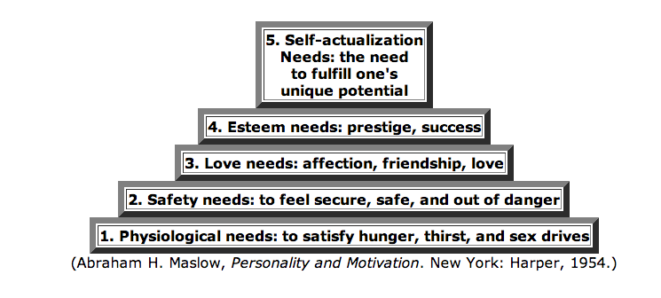
Maslow's "Hierarchy of Needs" Theory and the Younger Family in Hansberry's A Raisin in the Sun
(Aham H. Maslow, Personality and Motivation. New York: Harper, 1954.)

