Slide 1
Common Errors in YOUR Writing

Slide 2
POV
Thou shalt write in 3rd person only.
(he, she, it, them)
Correct this:
“If you leave your textbook at home, what can you do about it? You can look online.”

Slide 3
Verb tense
Write in present tense.
She explained in her article, “Thanksgiving” that Native Americans were treated unjustly.

Slide 4
What’s correct?
"I think that using technology can and will hinder your ability to learn the English language."
OR
"Using technology will hinder your ability to learn the English language."

Slide 5
What’s correct?
"Teenagers, I'm sure, are the main age group to use the internet. . . "
OR
"Teenagers are the main age group to use the internet."

Slide 6
Wrong homophone
“Two bee, oar knot two bee.”
. . .
How to fix it: PROOFREAD, PROOFREAD, PROOFREAD.

Slide 7
apostrophes
I dont use them out either because of laziness or due to a lack of proofreading.

Slide 8
commas

Slide 9
commas
The Native Americans found them, sheltered them and taught them to be self-sufficient.
A person that constantly uses the Internet uses the Internet on a computer, phone or tablet will become “hooked” to his device, and want to be on it as much as possible.

Slide 10
, and versus ;
Make Ms. Server proud; master the semicolon.
Make Ms. Server proud, and master the semicolon.
Use the semicolon; however, if you still currently doubt how to use it, then don’t!

Slide 11
Fix these.
When told to do something; teens get distracted by the internet.
I like math class better than physics; but I still like history the best of all.

Slide 12
thesis & introductions
Introduction Do’s:
-explanation/overview of paper (history, background, controversy)
-grabs attention
-establishes significance
-establishes controversy
Introduction Don’ts:
-begin with a dictionary definition of an idea
-treat it as a body paragraph (facts, ideas)
-start with a grand generalization
-use rhetorical questions

Slide 13
thesis & introduction
Your thesis should be the last sentence in your introduction, not the first sentence.
-Each body paragraph should prove the thesis.
-Each body paragraph should have a concluding statement/wrap up the ideas .
-It’s okay to go back and tweak your introduction afterwards! I encourage it!

Slide 14
etc.
It does no good and stuff etc.
It doesn't help you prove your point etc.
It actually reveals you do not have another point. If you only have two points, state only those.
There are many more reasons why technology benefits education. . . .

Slide 15
etc.
They are exposed to sites, such as:Facebook, Instragram, Tumbler, etc.

Slide 16
etc.
A sneaky way around it is to substitute "like such" or "the like". . .
"In school or at home, teenagers like myself can search for help for homework, projects, research, and more."
Replace with "the like".

Slide 17
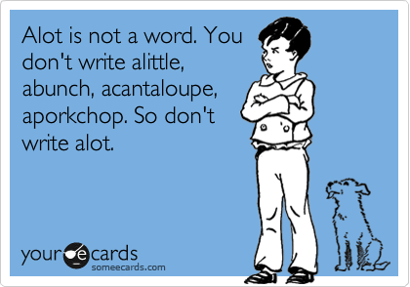
Alot
“A lot” is an elementary expression, so use “many” instead.

Slide 18
Coordinating Conjunctions
And that is why the internet is harmful.
But actually, the internet is helpful.
Because students waste too much of their lives on the internet, the internet adversely affects students.

Slide 19
elementary words
Big
Small
Bad
Good
Amazing
Awesome
Great

Slide 20
diction: descriptive adjectives
Use descriptive word choices!
-Effective
-Immense
-Intriguing
-Insightful
-Vibrant
-Relevant

Slide 21
diction: descriptive verbs
overused words:
-linking verbs
-“show”
Verbs to use when discussing literature:
-demonstrate
-portray
-exemplify
-signify
-reflect
-reveal

Slide 22
fragments: mayday!
-Beginning a sentence with “such as” or “like” immediately makes it a fragment

