Slide 1
Excerpt from the Epic of Gilgamesh
A SUMERIAN MYTH
WORLD LITERATURE

Slide 2
Literary Terms

Slide 3
Sacred Literature as mythology
What is a myth?
Myths serve as traditional stories about gods and goddesses that serve to explain the natural phenomena, the human situation, or the origin of a belief or ritual. The Epic of Gilgamesh incorporates several Sumerian myths into its plot.

Slide 4
What is a quest?
*A journey to find a treasure, achieve a goal, (such as bringing back a valuable object or acquiring knowledge) or undergoing a personal transformation.
*What are some examples of quests?
*An epic is a long narrative poem celebrating the great deeds of one or more legendary heroes, in a grand ceremonious style.

Slide 5
What is an archetype?
Common elements such as situations, characters, or images that appear again and again in literature and art are called archetypes.
Archetypes provide good analogies for life and exploration. They reflect universal characteristics of the human experience and apply to all people, regardless of time or culture.

Slide 6
A quest hero has special powers or special friends that help (or hinder) him or her on the journey.
**As you read this story, notice what powers or friends Gilgamesh has and the roles they play in his quest.*

Slide 7
A little history. . .because literature derives from it!

Slide 8
Some of the oldest written literature in the world comes from the
1) Mesopotamians, (present-day Iraq)
2) Egyptians, and
3) Hebrews.

Slide 9
Sumerians: 3500-2350 B.C.
the first Mesopotamians
invented cuneiform writing: the world’s first writing, appeared “wedge-shaped”. . .
What does writing set the groundwork for?
lived in large city-states with their own ruler, army, and patron deity (god).

Slide 10
Cuneiform

Slide 11
Akkadians: 2350-2000 B.C.
conquered & united city-states, creating the world’s first empire
adopted much of Sumerian culture (religion & literature)

Slide 12
Babylonians: 2000-1570 B.C.
conquered Mesopotamia in x. 2000 B.C. with its capital, Babylon on the Euphrates River.

Slide 13
Babylonians: laying down the law
King Hammurabi established one of the first sets of laws--The Code of Hammurabi

Slide 14
Assyrians: 850-612 B.C.
King Ashurbanipal established a library, preserving many Sumerian & Babylonian writings, including The Epic of Gilgamesh.
Discovered in 1849

Slide 15
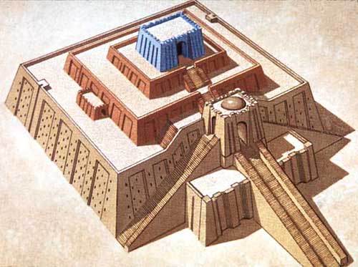
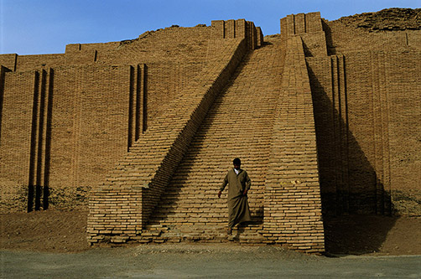
Mesopotamian accomplishments:
“ziggurats” (towering temples)
hanging gardens
wheels
the sail
the plow
arithmetic
geometry
maps

Slide 16
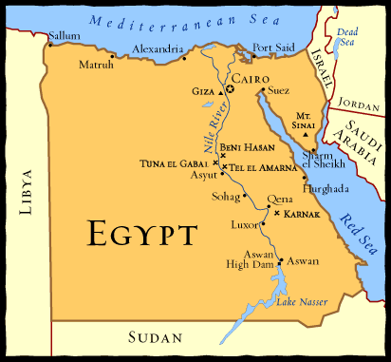
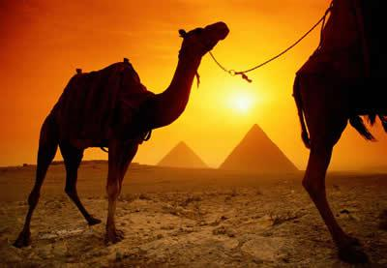
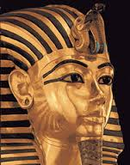
Egypt:
divided into three parts:
Old,
Middle, &
New Kingdoms

Slide 17
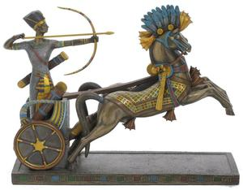
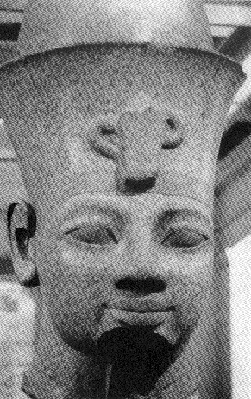
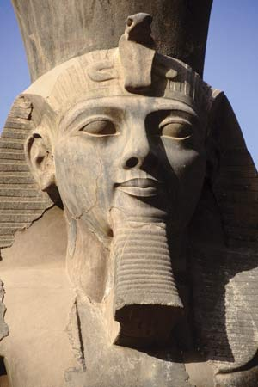
During the New Kingdom. . .
Egypt became the strongest power in the world and fought with bronze weapons and two-wheeled chariots.
Thutmose III and Rameses II ruled in this dynasty.
Egypt was conquered by the Assyrians in 671 B.C.

Slide 18
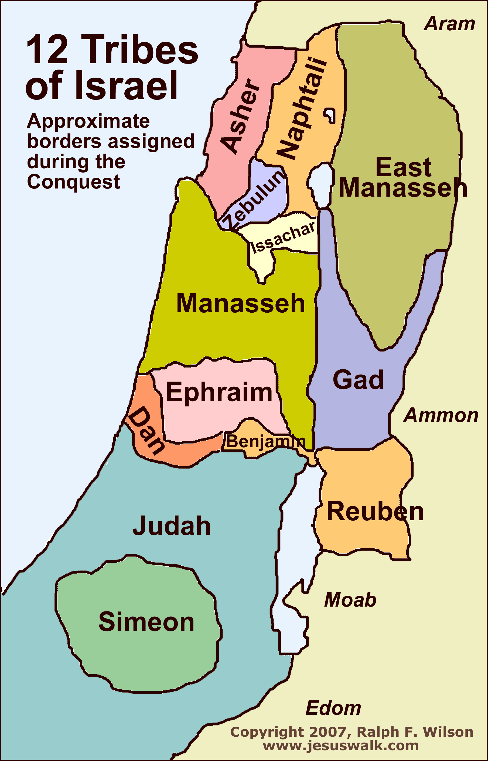
Hebrews:
The early Hebrews (Jews) were descendents of Abraham. Abraham was the grandfather of Jacob, known as Israel. Israel’s twelve sons were the heads of the Twelve Tribes of Israel.

Slide 19
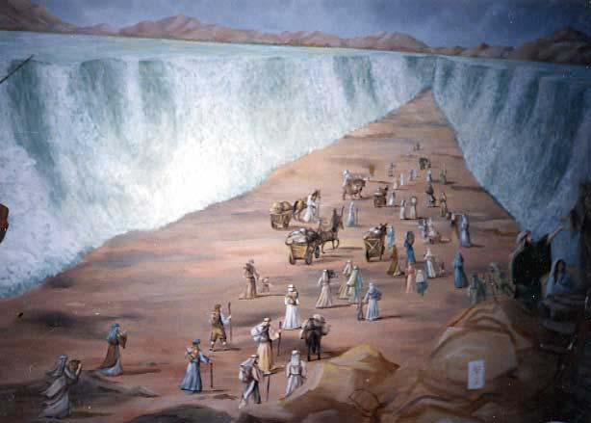
The Exodus: 1200- 1020 B.C.
To escape famine, the Jews moved from Canaan back into Egypt. Over time they became enslaved by the Egyptians until Moses led them back to Canaan.

Slide 20
The Kingdom of Israel:
The Hebrews became united under King Saul’s ruling.
King David established Israel.
David’s son Solomon built the Temple of Solomon in Jerusalem.
After Solomon’s death, the kingdom split into the two kingdoms of Israel & Judah.

Slide 21
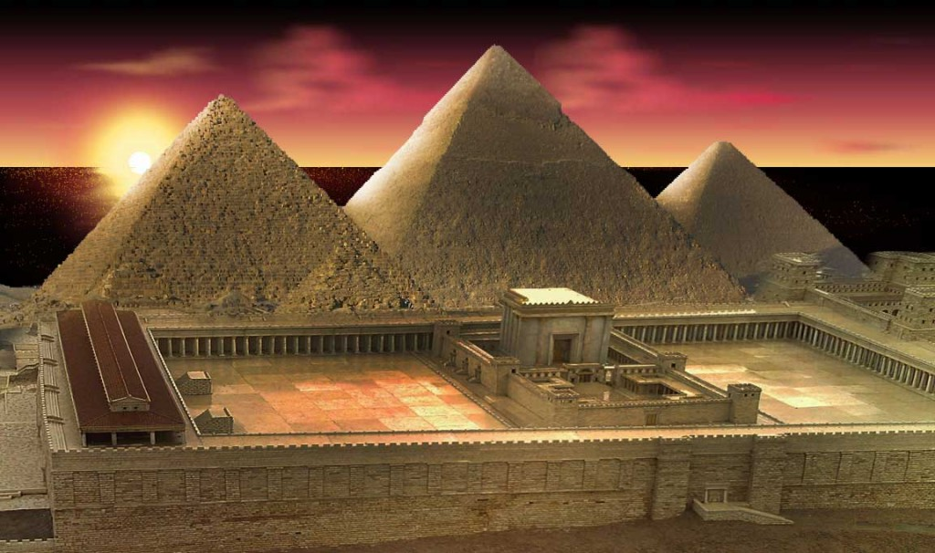

Slide 22
Things we’ll talk about in this unit. . .
How do these stories reflect beliefs and events that are significant to us today?
Can you see any archetypes (common situations, characters, or images that frequently appear) that are still used in modern literature you’ve read?
Why should we read literature today?

Slide 23
Encounter
Helps/Hinders/Both
What Gilgamesh Does
lions
hinder
*Prays to moon god for protection
*attacks and scatters the lions

Slide 24
Definition of Heroism
How would you define heroism?
Before writing, think about the kind of heroism Gilgamesh demonstrates at different points in the story. Consider how your ideal hero would compare with Gilgamesh. Then write a paragraph (6-8 sentences) giving your definition.
**Be sure to include some specific examples of heroic behavior.

