Slide 1
Monday, 11/11/13
WHS: American Literature & Composition A

Slide 2
Daily Agenda: Monday, 11/11/13
No bell-ringer today
Personal declarations of independence = ½ credit today only
Watch The History of Slavery & take notes.
Read excerpt from The Interesting Narrative of the Life of Olaudah Equino pp. 93-97 & answer select questions.
Expect a pop quiz over revolutionary lit. soon!

Slide 3
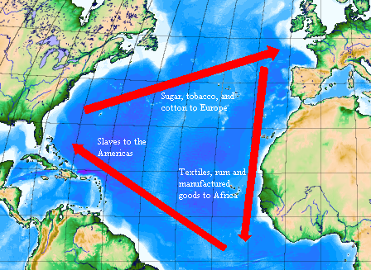
The Middle Passage

Slide 4
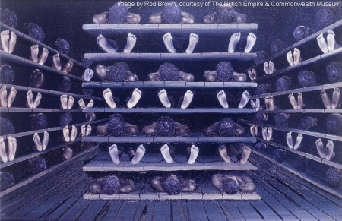

Slide 5
Daily Agenda:
Slave narratives are autobiographical accounts by persons who suffered the horrors of slavery.
2 examples we’re reading:
excerpt from The Interesting Narrative of the Life of Olaudah Equino
excerpt from Narrative of the Life of Frederick Douglass

Slide 6
Class work/Homework:
We will finish reading this in class tomorrow.
Pg. 98:Answer questions: 1 (Comprehension check questions), 3, 5, and 8, and file in your notes!

