Slide 1
Friday, 1/17/14
FCHS: World Literature & Composition B

Slide 2
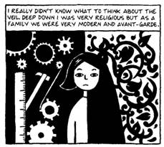
Bell Ringer: Friday, 1/17/14 What does this picture symbolize? Come up with three ideas.

Slide 3
Daily Agenda:
Mrs. Vandemotter/AP language (junior year)
Bell ringer
Copy vocabulary from Persepolis
Continue reading Persepolis: Chapter, “The Water Cell”, pp. 18-26 and answer reading guide questions.

