Slide 1
FCHS: World literature & composition a
Friday, 10/11

Slide 2
Bell Ringer: Friday, 10/11
before moving to brooklyn heights in new york ny five years ago tj lived with his family in the south and subsequently moved back there

Slide 3
Corrected:
Before moving to Brooklyn Heights in New York, NY, five years ago, T. J. had lived with his family in the South, and, subsequently, moved back there.

Slide 4
Daily Agenda:
Tracing sources of wisdom through philosophy
Confucianism & Taoism
Begin reading The Tao of Pooh.
Read to the top of page 16.

Slide 5
The Vinegar Tasters

Slide 6
Nirvana

Slide 7
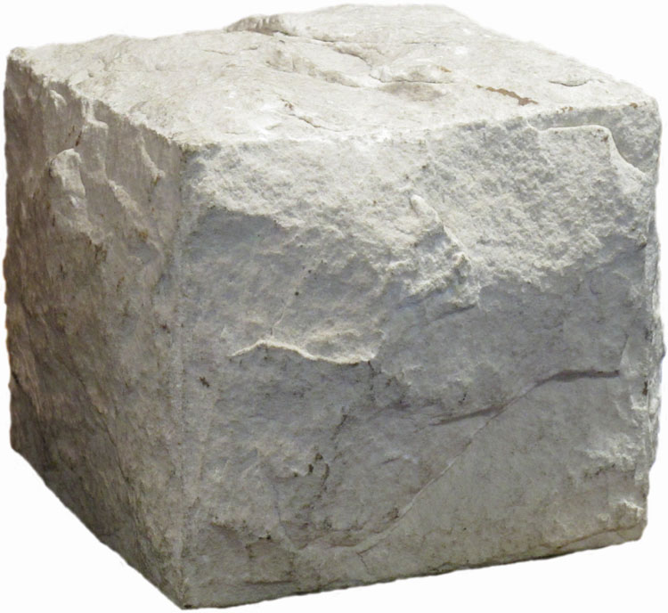
The “uncarved block”

