Slide 1
Monday, 10/14
FCHS: World Literature & Composition

Slide 2
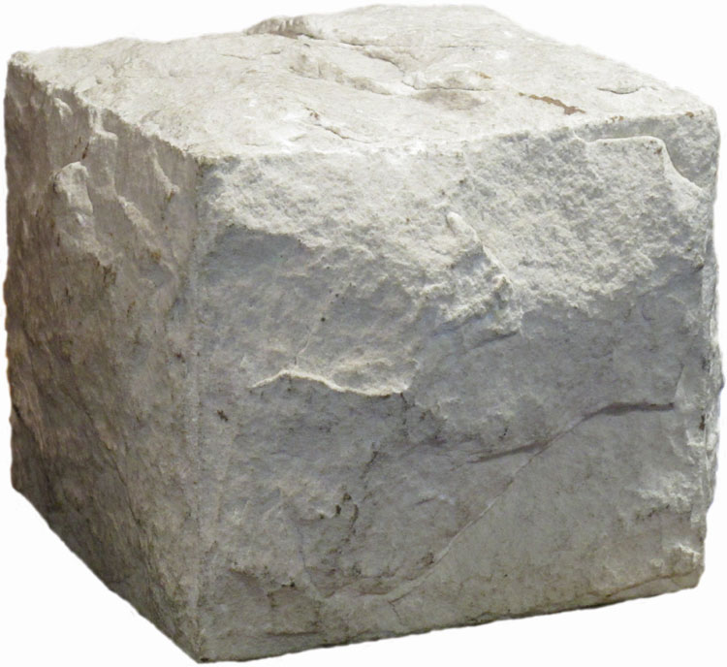
Bell Ringer: Monday, 10/14
Free write/journal in your notes: What do you notice about this block? (Hint: What is “uncarved block”?)

Slide 3
Daily Agenda:
Finish The Tao of Pooh today.
Notes/Discussion of The Tao of Pooh
1. How does Hoff explain the “uncarved block” metaphor?
2. What is the secret message of the “uncarved block? 3. What is the difference between “simple” and “stupid” as revealed by Hoff?

Slide 4
Daily Agenda:
1-2 paragraphs
https://www.youtube.com/watch?v=EDkCOA5xDQ8
TOTD Application: Which character in Winnie the Pooh exhibits the most Taoists characteristics? How so?
Tomorrow/this week:
Read & discuss Lao-tzu’s “Tao Te Ching” Plato’s “Allegory of the Cave” tomorrow.
PSAT Wednesday: 1st-3rd periods in the afternoon only

