Slide 1
"Crash Course Writing"
. . . So that you don't crash my course with your writing.

Slide 2
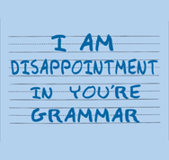
Grammar, not grammer. . .

Slide 3
Common errors. . .
They are mistakes the first time.
They are bad habits in-the-making the second. . . and third and fourth!

Slide 4
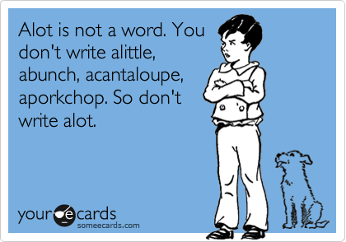
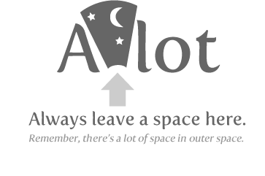
A lot is two words. . . But the expression is weak, so don't use it anyway.

Slide 5
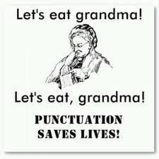
Punctuation. . .

Slide 6
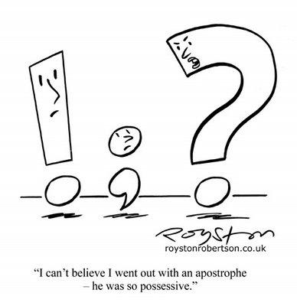

Slide 7
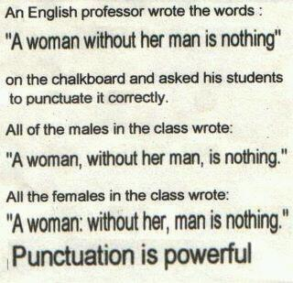

Slide 8


Slide 9
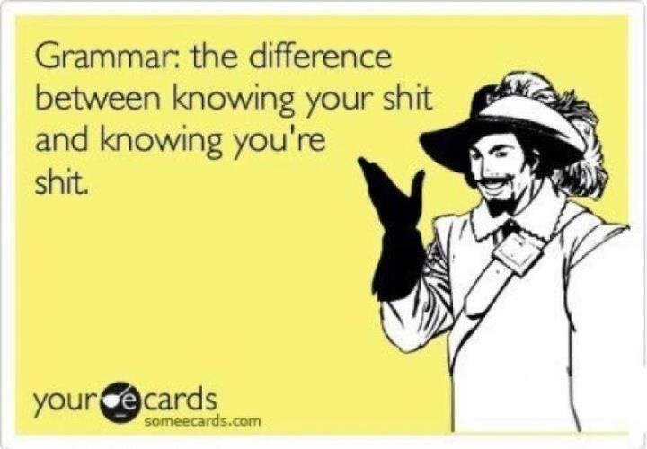
crap
crap

Slide 10
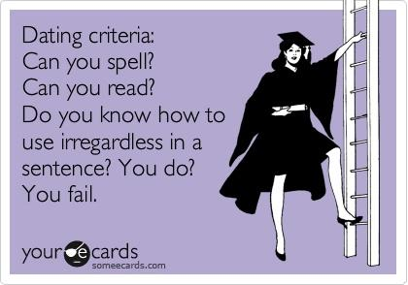

Slide 11
Not words
AnywayS
alot
irregardless
theirselves

Slide 12
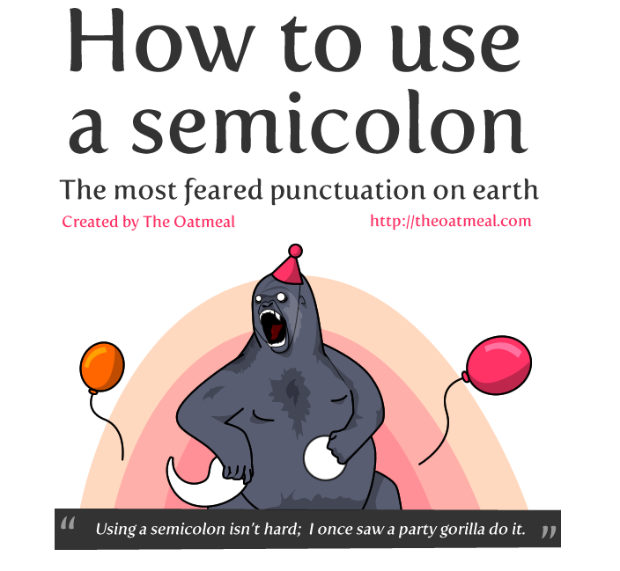

Slide 13
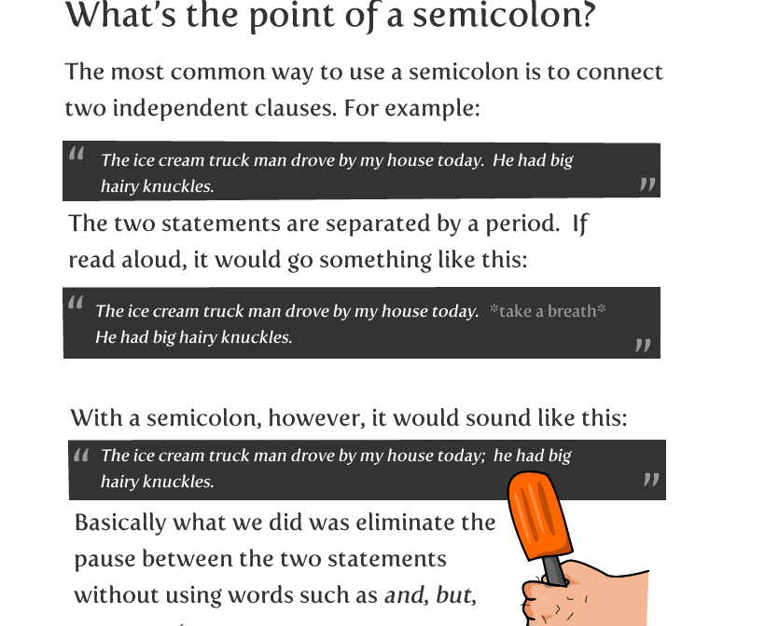

Slide 14
When to use a semicolon?
to form a bond between two statements, esp. if you're comparing/contrasting two things

Slide 15
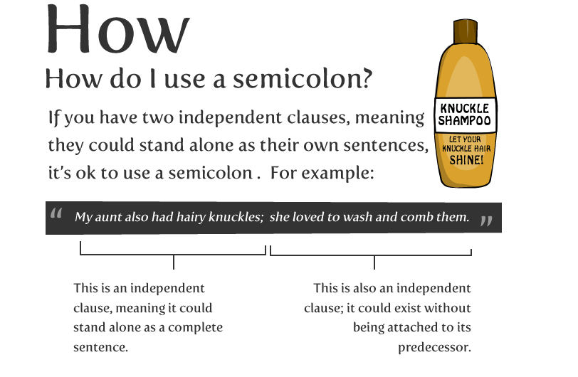

Slide 16
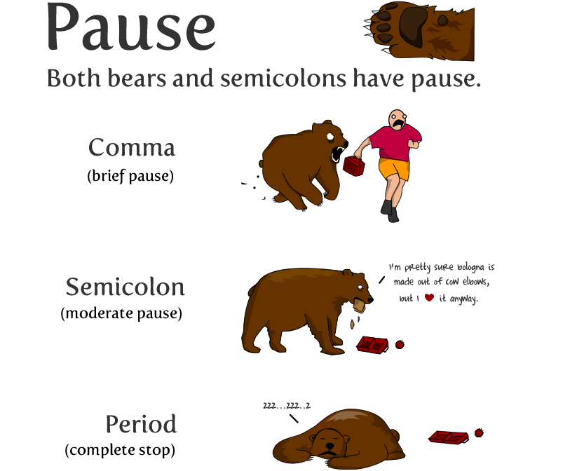

Slide 17
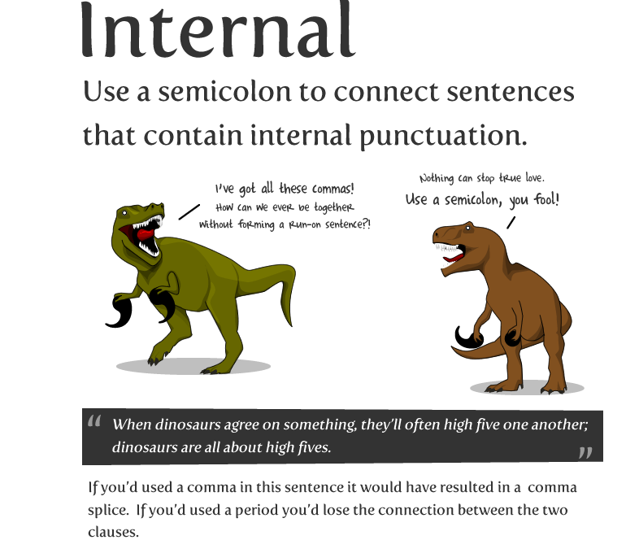

Slide 18
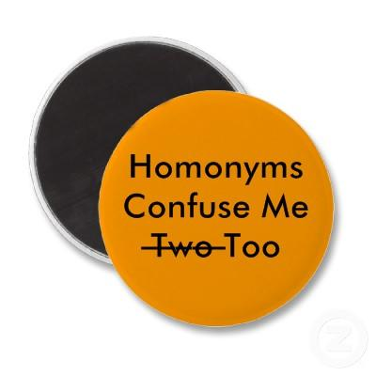
Homonyms/homophones
Use the correct word!
This is why proofreading
is important!

Slide 19
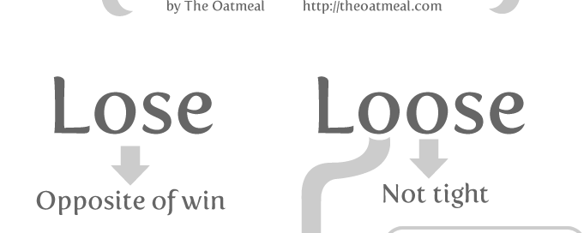
Spelling. . .

Slide 20
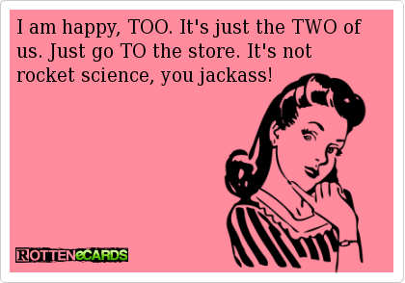

Slide 21
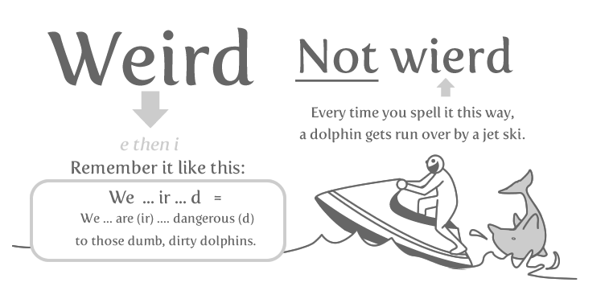

Slide 22
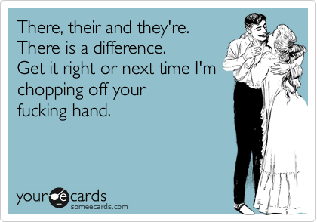

Slide 23
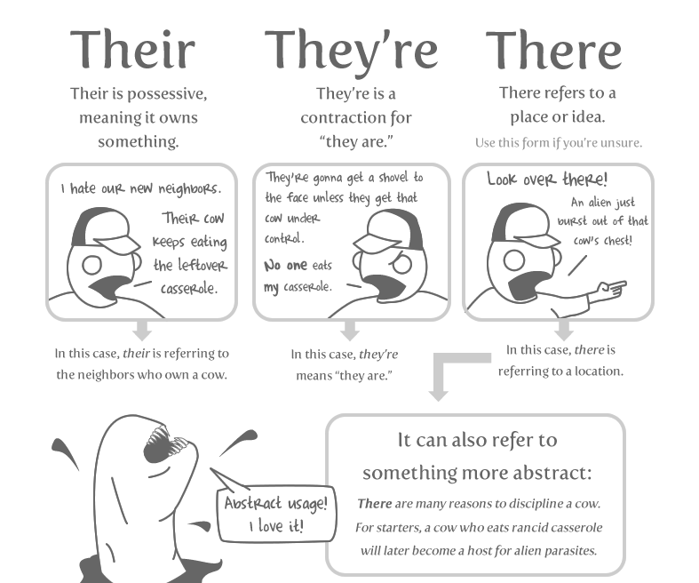

Slide 24
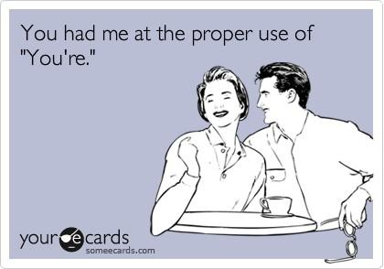

Slide 25
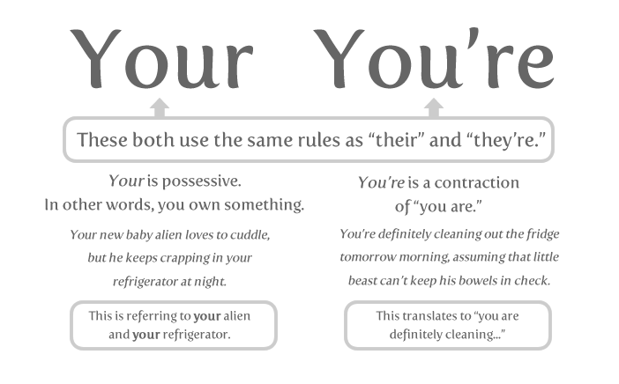

Slide 26
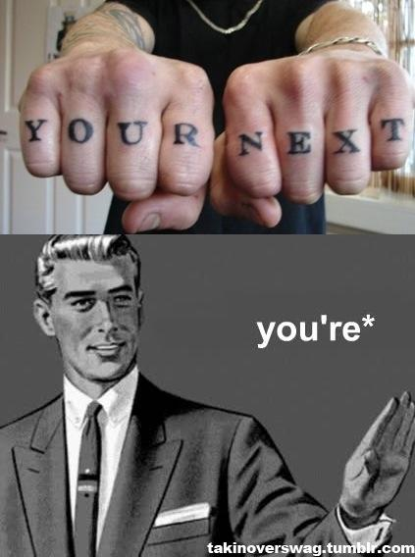

Slide 27
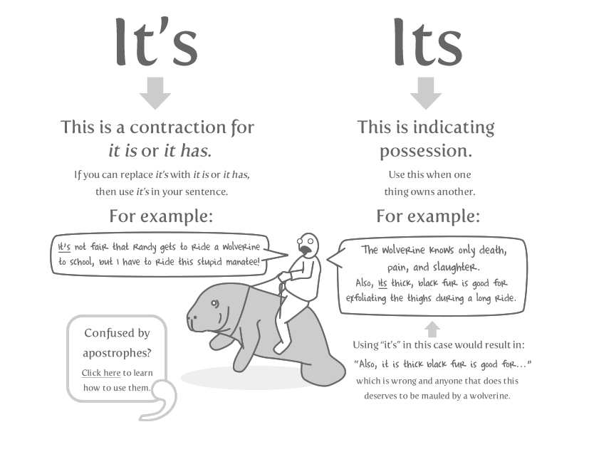

Slide 28
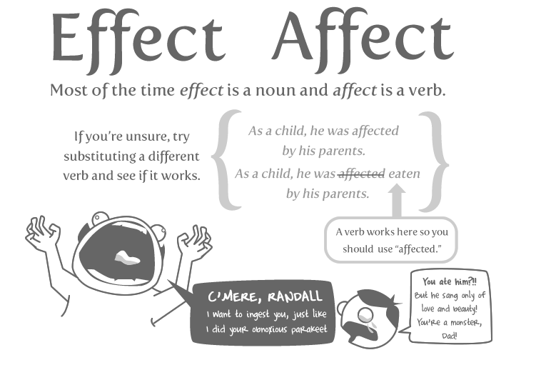

Slide 29
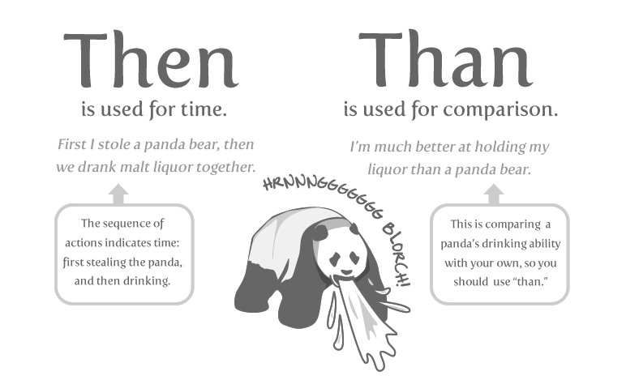

Slide 30
Diction (word choice)
Another great reason I believe technology is awesome is because of how portable and easy to use it is.
Replace these "filler" words with what you are trying to relay to your audience.

Slide 31
The power of persuasion
Sound as strong yet as clear and concise as possible!
"I think that using technology can and will hinder your ability to learn the English language." OR
"Using technology will hinder your ability to learn the English language."

Slide 32
Helping & linking verbs = lame
Avoid meaningless helping verbs!
"When they do go there. . ."

Slide 33
Don’t do it!
Textese
contractions "won't", "shouldn't", "can't" etc.
abbrevs
"excessive use of you"
starting sentences with "I think. . . "
State it as a fact.

Slide 34
Opinion, or opinion that sounds like a fact?
"Teenagers, I'm sure, are the main age group to use the internet. . . "
OR
"Teenagers are the the main age group to use the internet."

Slide 35
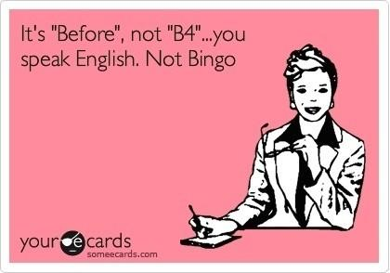
Treat every writing as a FORMAL writing.

Slide 36
Etc.
It does no good and stuff etc.
It doesn't help you prove your point etc.
It actually reveals you do not have another point. If you only have two points, state only those.
There are many more reasons why technology benefits education. . . .

Slide 37
But if you must. . .
A sneaky way around it is to substitute "like such" or "the like". . .
Por ejemplo, "In school or at home, teenagers like myself can search for help for homework, projects, research, and more."
Replace with "the like".

Slide 38
Prepositions
Never use a preposition to end a sentence with. Winston Churchill, corrected on this error once, responded to the young man who corrected him by saying "Young man, that is the kind of impudence up with which I will not put!

Slide 39
S/V agreement
Verbs HAS to agree with their subjects.
(Please tell me that you know what is wrong with this.)

Slide 40
S/V agreement
"Educational purpose was the reason electronic devices was allowed."
Devices were.
Plural subject, plural verb.

Slide 41
Verb tense
It must stay the same per paragraph.
If you start with a verb in present-tense, you must keep that paragraph in present-tense.
The next paragraph is a different story. . .

Slide 42
Symbols are weak.
He OR she, not he/she.

Slide 43
Audience
Don't assume they know what you're talking about!
If there is any ambiguity, make it clearer.

Slide 44
#'s < 100. . . .
Should be spelled out!
According to the AJC, "80% of Americans have cell phones".
WRONG.
Eighty-percent!

Slide 45
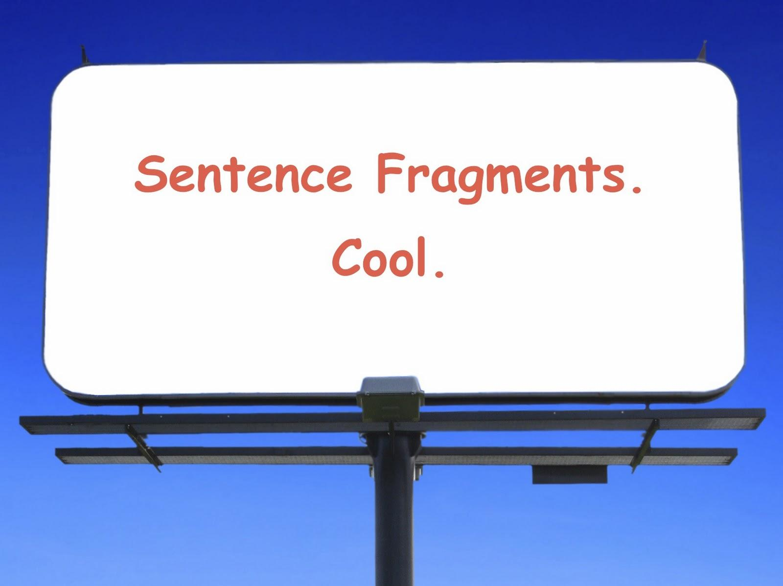
Fragments are the workings of the devil.

Slide 46
Fragments. . . .
"The knowledge of all the world at anyone's fingertips."
"So, with the fact that people use computers on a daily basis and that most jobs require computer knowledge."
Simple fix: How?

Slide 47
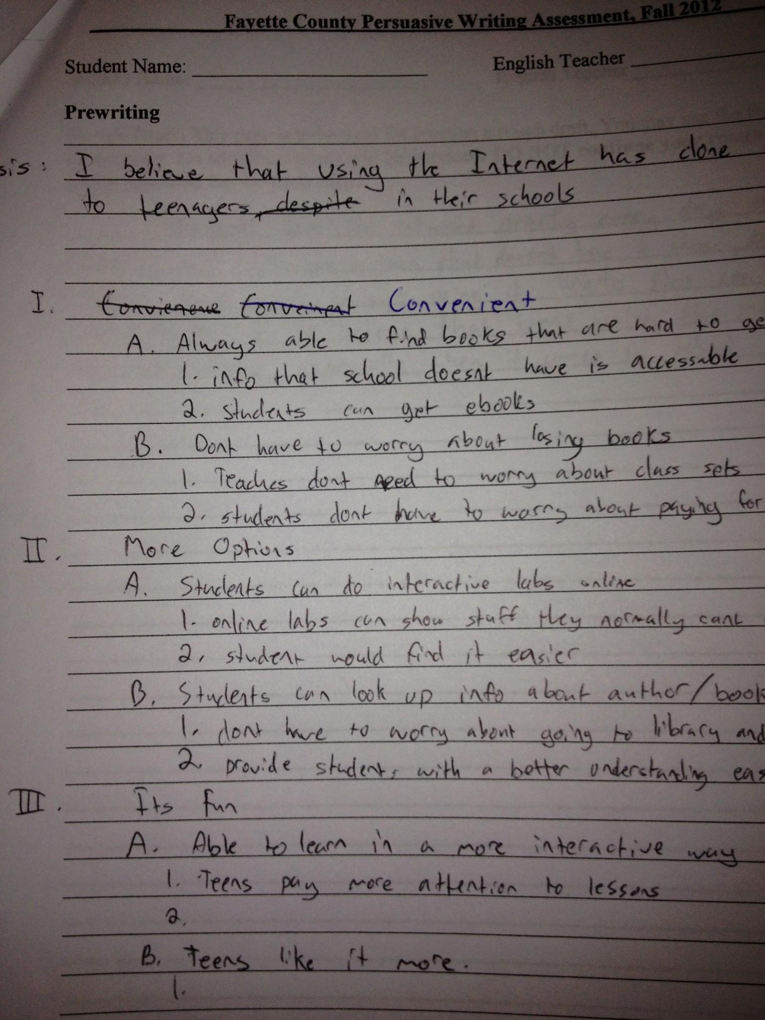
The good. . .

Slide 48
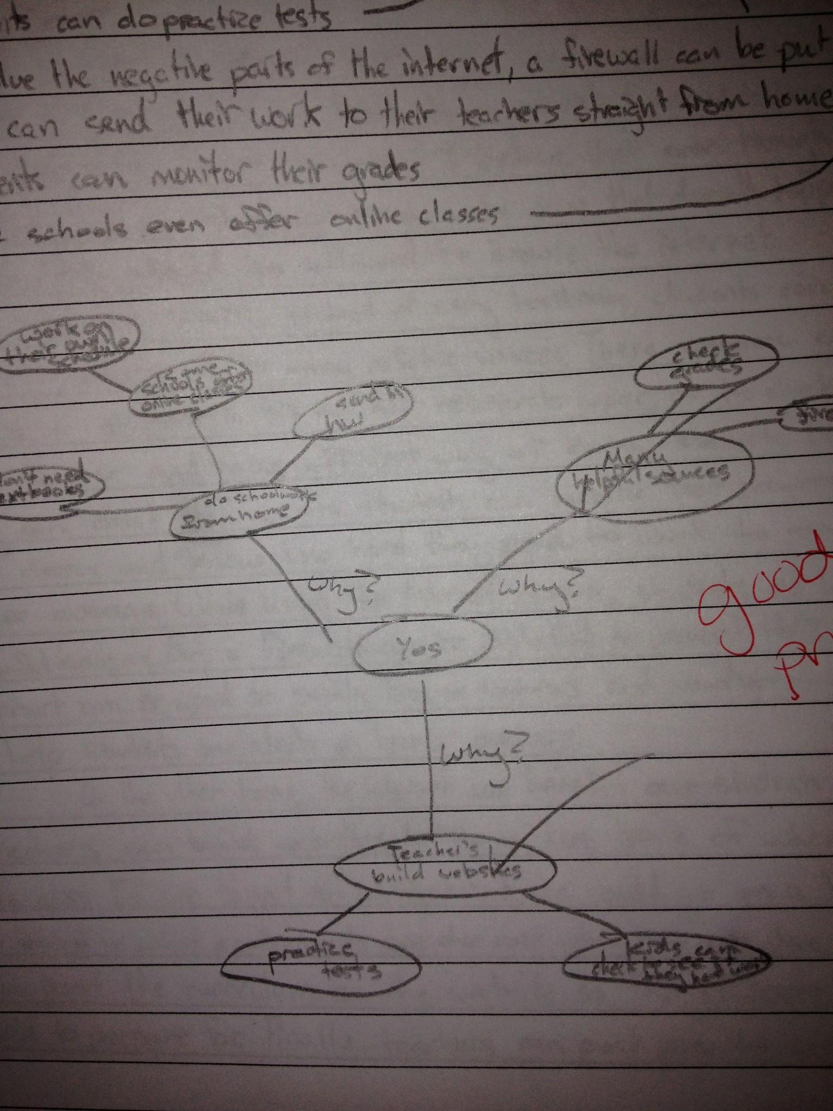
The good. . .

Slide 49
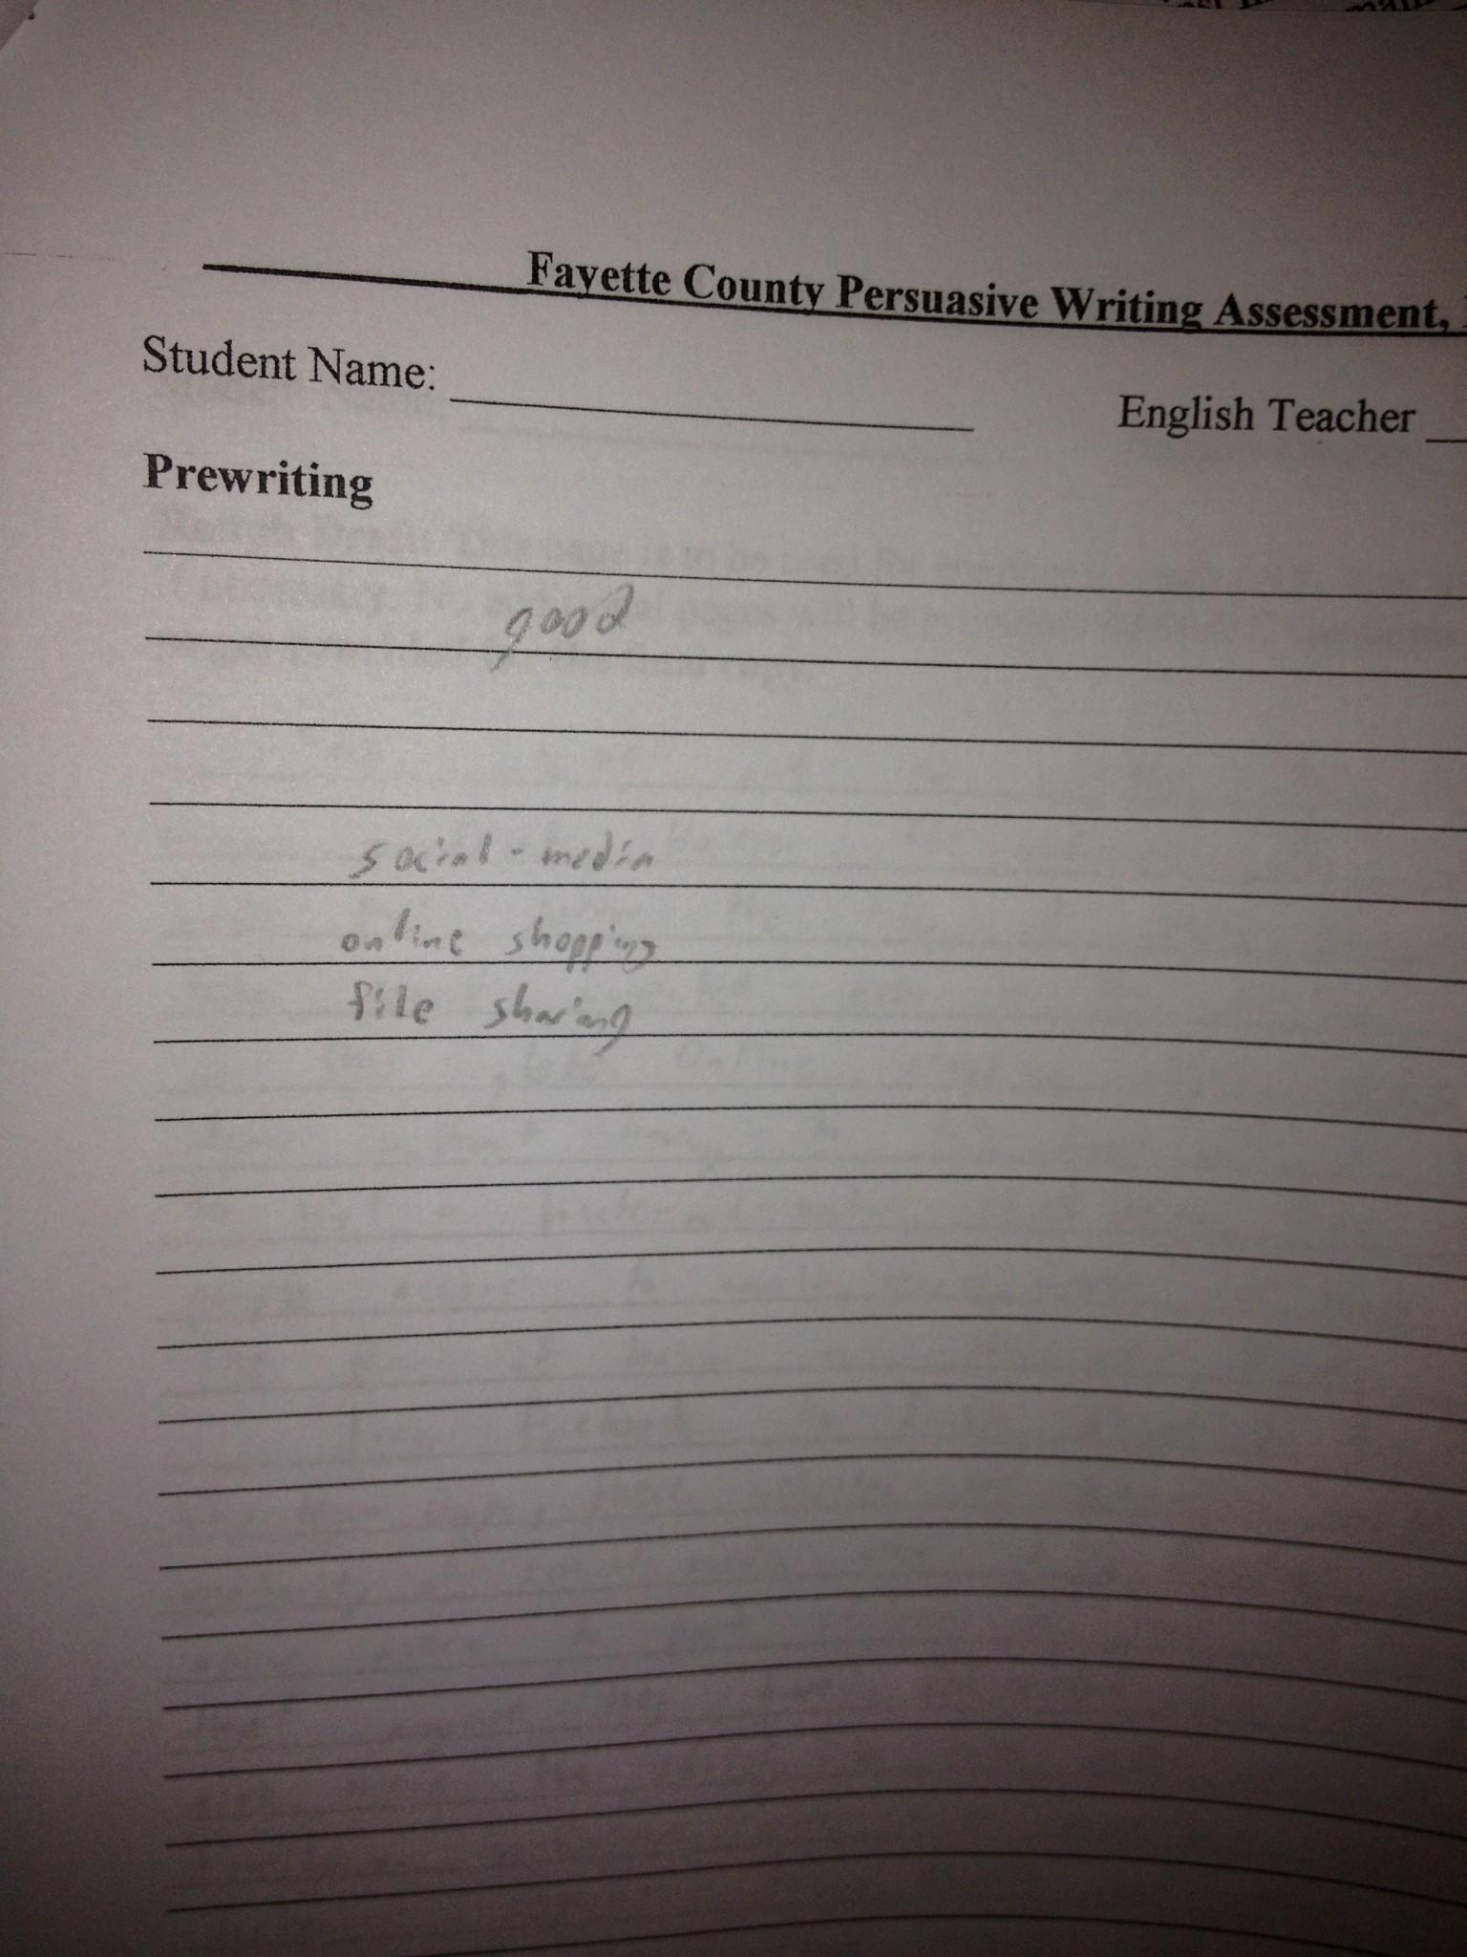
The bad. . .

Slide 50
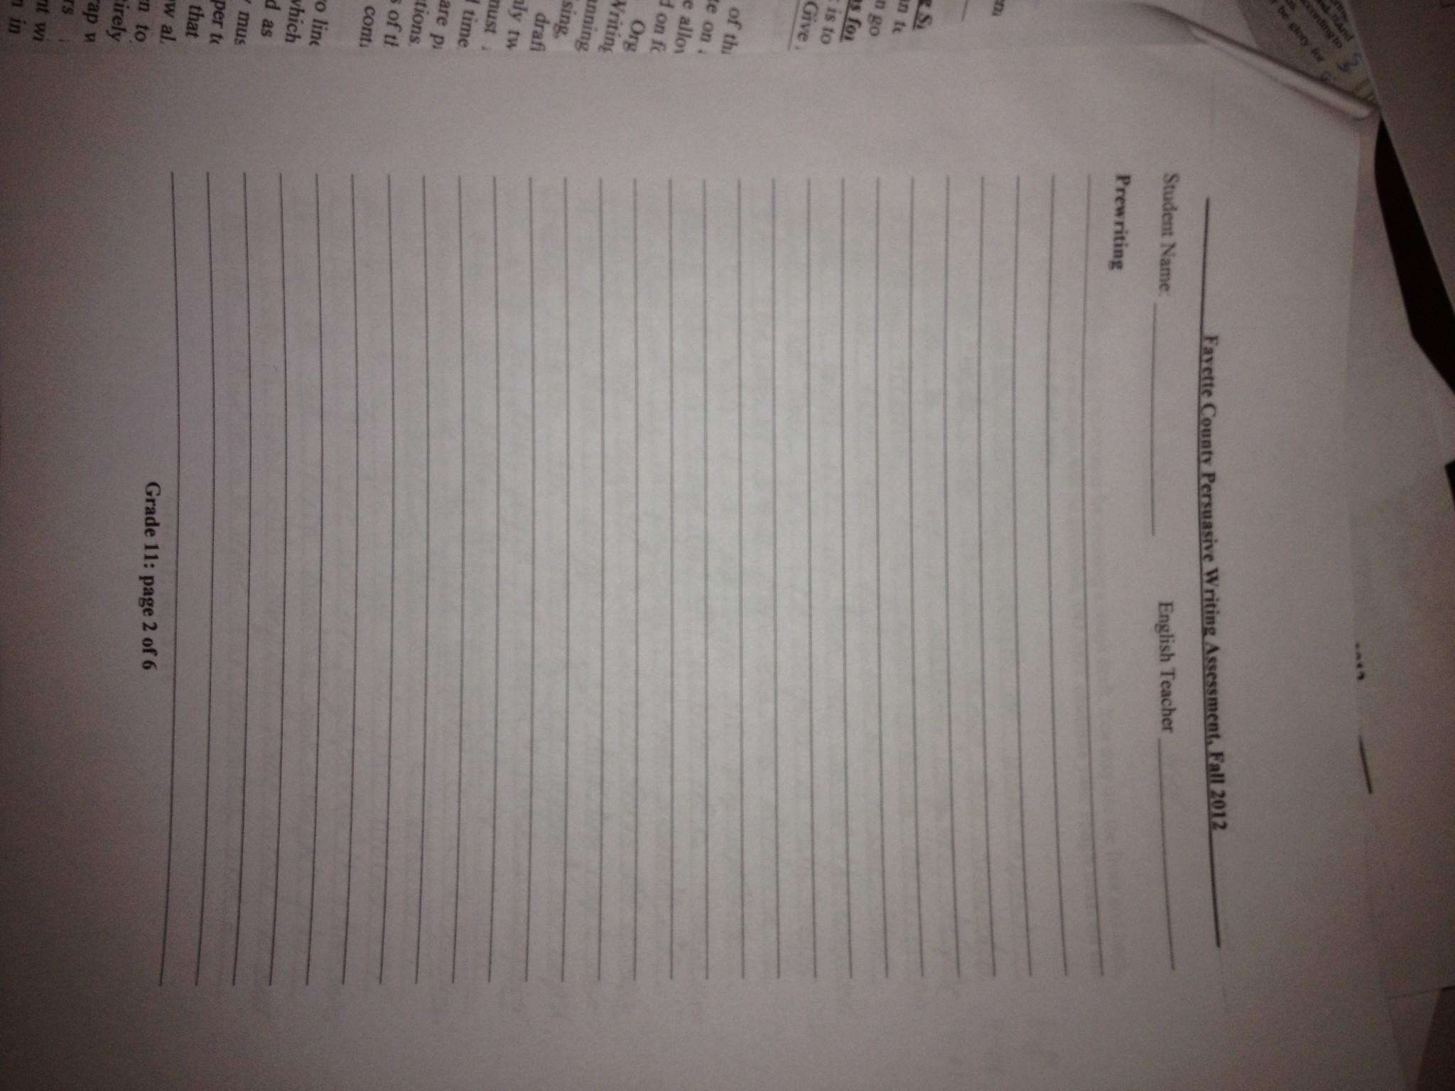
And the ugly. . .

