Slide 1
Wednesday, 11-05-14
9th Lit/Comp

Slide 2
Bell Ringer(s): Wednesday, 11-05-14
What do you think Bradbury is hinting about regarding the seashells in Mildred’s ears? (Hint: pp. 12 & 18)
Why are Mildred and Clarisse considered foil characters? (Use textual evidence.)
Describe Montag and Mildred’s relationship (using textual evidence).

Slide 3
Agenda:
ELACC11-12SL3: Evaluate text (characters, words, emphasis etc.)
ELACC9-10RL1: Cite strong and thorough textual evidence to support analysis of what the text says explicitly as well as inferences drawn from the text.
ELACC9-10RL2: Determine a theme or central idea of text and analyze in detail its development over the course of the text, including how it emerges and is shaped and refined by specific details; provide an objective summary of the text.
ELACC9-10RL3: Analyze how complex characters (e.g., those with multiple or conflicting motivations) develop over the course of a text, interact with other characters, and advance the plot or develop the theme.
EQ(‘s): What would the world be like without books? Why did Ray Bradbury name the novel what he did?
-No more vocabulary quizzes this semester. . . The vocabulary test will be TBA.
-Continue reading the novel, Fahrenheit 451. Read pp.
-Begin working on select pages in packet.
-Expect pop quizzes over the novel!
-Choose research topic by tomorrow.

Slide 4
Fahrenheit 451 Essay Topics: Choose one of the topics below by tomorrow!
♦ Censorship and the suppression of ideas.
♦ The power and value of ideas.
♦ The meaning of a life richly lived.
♦ The power of interpersonal relationships.
♦ The power of conflicting ideas in developing a concept of truth, and the risk
to the uneducated or ignorant of falling prey to propaganda.
♦ The deadening power of technology when it suppresses or replaces true
human interaction or experience.
♦ The value and meaning of a free society. (While there are some risks to a
free society, the threat of a society that suppresses freedom is the very
possibility of being truly human.)

Slide 5
Notes:
1st (green sticky notes): pp.
5th (yellow sticky notes): pp.
7th (blue sticky notes): pp.

Slide 6
Notes/Literary Terms:
Epigraph: a short quotation or saying at the beginning of a book or chapter, intended to suggest its theme.
If they give you ruled paper,
write the other way (Jimenez).

Slide 7
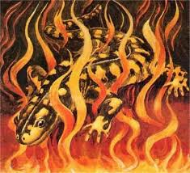
Notes:
Salamander: a mythical lizard-like creature said to live in fire or to be able to withstand its effects.

Slide 8
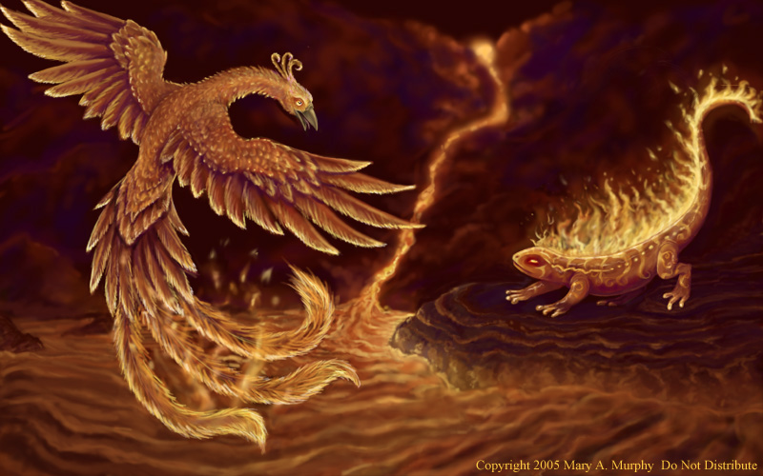
The salamander & phoenix

Slide 9
Why is this true?

Slide 10
1st Period: Technology Volunteers
•Leylah
•Breanna
•Dierra
•J. Forbes.
•Keirah
•Kaiya
•Whitney
•Taryn

Slide 11
5th Period: Technology Volunteers
•Cierra Walton
•Christian
•Robby
•Jabari
•Spencer
•Lindsey*
•Rheanna*
•Maurice
•Drevante

Slide 12
7th Period: Technology Volunteers
•James
•Vasthi
•Xzavier
•Adam
•Tia
•Oliver
•Caitlin
•Alyssa
•Laura
•Tyrica
•Nia
•Uriah
•Jarred
•Trinity
Jalil

Slide 13
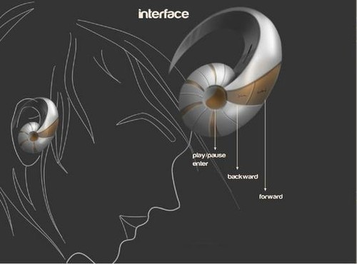
What do you think Bradbury is hinting about regarding the seashells?

Slide 14
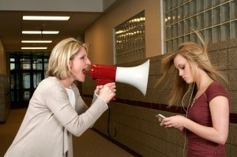
HINT HINT:

Slide 15
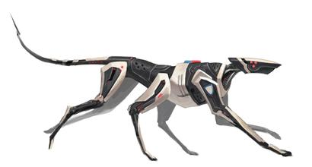
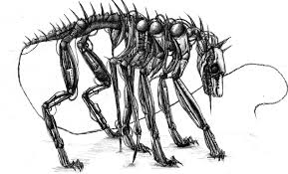
the Mechanical Hound

Slide 16
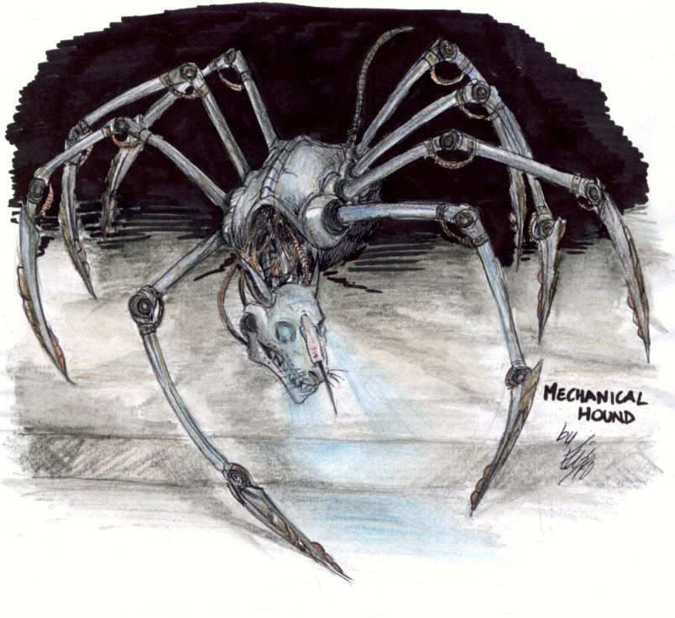
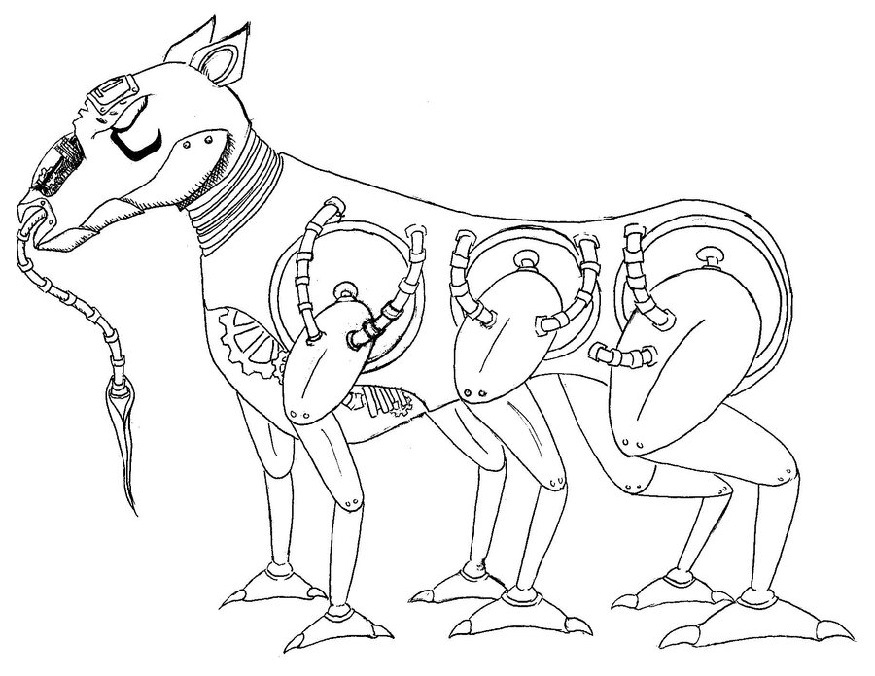
The Mechanical Hound

