Slide 1
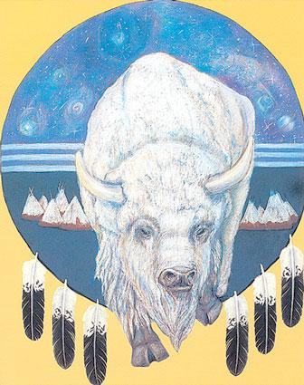
Native American Literature: Creation Myths

Slide 2
Read background notes/pg. 20 in textbook.
Native American Literature

Slide 3
What is a myth?
The word itself comes from the Greek "mythos" which originally meant "speech" or "discourse"

Slide 4
Sacred Narratives
A more culturally sensitive term for “origin myths” or “creation myths”
No culture appreciates their beliefs being called “myths”…
Would you appreciate Genesis being called “Hebrew mythology”?

Slide 5
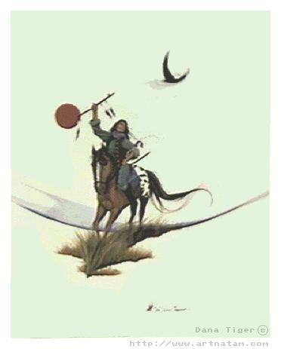
What is a myth?
A traditional story explaining how the world and the things in it came to be

Slide 6
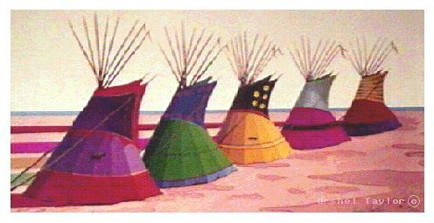
Oral tradition
Native American myths originated as oral tradition: stories passed down verbally

Slide 7
Four functions of myth:

Slide 8
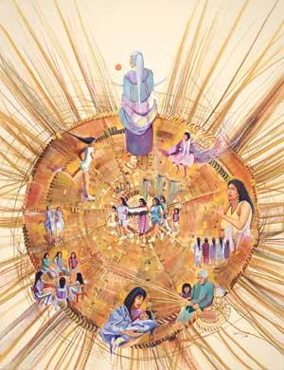
1. To awaken us to the mystery and wonder of creation

Slide 9
2. To explain the workings of the natural world: every corner, every rock, hill, stone, and flower has its place and its meaning.

Slide 10
3. To pass down the moral and ethical codes that support and validate social customs.

Slide 11
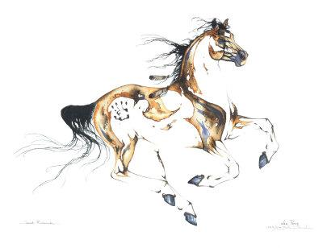
4. To teach:
to guide the people through the trials of living

Slide 12
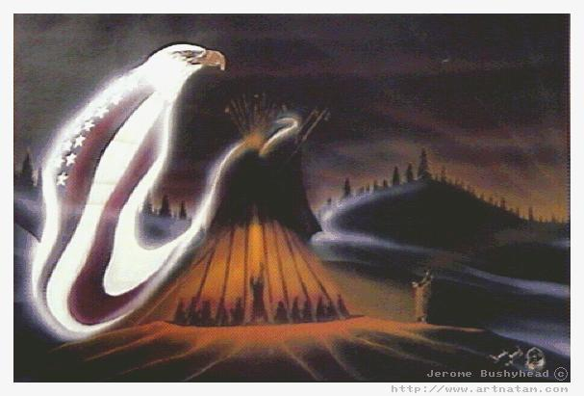
Creation myths
Explain how the universe, the earth, and life on earth began.

Slide 13
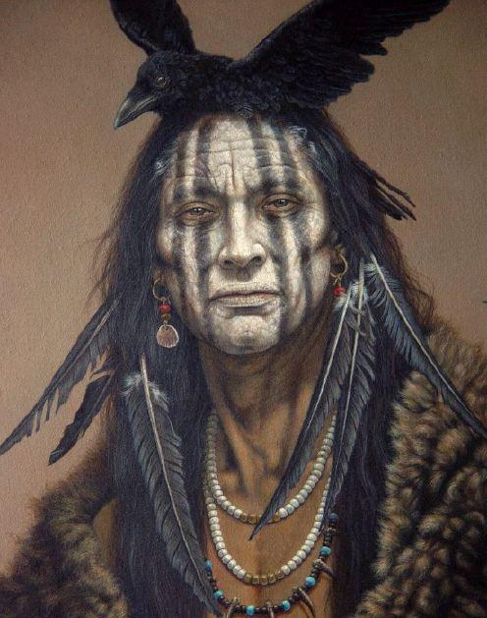
Essentials of Creation Myths

Slide 14
Creation Myths…
SHOW WHAT IS IMPORTANT TO THE TRIBE! (corn, animals, rituals, etc.)
State the place and people of origin
3. Describe what existed before the “creation”
4. EXPLAIN the “creation” of things or the beginnings of rituals
5. EXPLAIN who or what did the creating

Slide 15
Sound Familiar?

Slide 16
Application. . .
Introduction to Native American Literature. Read “The World on the Turtle’s Back.” Finish for homework, and answer corresponding questions for homework due ?? (homework grade).

